Slide 1
Searthing Algorithms
Introduction

Slide 2
What is a Search Algorithm??
Definition:
A search algorithm is a method for locating a specific item in a collection of items, such as an array, list, or database.
Purpose:
To retrieve data efficiently from a data structure based on a specific condition or criterion.
Common Characteristics:
Input: A collection of data (e.g., array, list, graph) and a target value to find.
Output: The position of the target value if found, or an indication that it is not present.
Performance: Measured in terms of time complexity and space complexity.
Applications:
Database queries
AI and machine learning
Navigation systems
Text searching in documents
Notes:
Sorting arranges data in an organized format, making it easier to search, retrieve, and analyze. It’s one of the most essential tasks in programming and data handling, especially for optimizing performance in various algorithms and applications.

Slide 3
Types of Basic Sorting Algorithms
Linear Search
Definition: A sequential search method that checks each element in a list until the target is found or the list ends.
Binary Search
Definition: A search algorithm that divides a sorted list into halves to locate a target value, requiring the list to be sorted beforehand.
Depth-First Search (DFS)
Definition: An algorithm for traversing or searching tree or graph data structures that explores as far down a branch as possible before backtracking.
Breadth-First Search (BFS)
Definition: A search algorithm that explores all neighbors of a node before moving on to the next level, ensuring the shortest path in unweighted graphs.
Notes:
sorting algorithms work by comparing elements to determine their order. Bubble Sort is straightforward but less efficient, while Selection and Insertion Sorts are useful for smaller datasets. Merge Sort and Quick Sort are efficient and suitable for larger datasets, thanks to their O(n log n) performance.

Slide 4
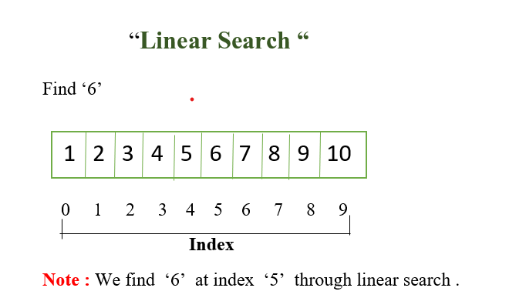
Linear Search
Definition:
A simple search algorithm that checks each element in a list sequentially until the target value is found or the list ends.
How It Works:
Start from the first element of the list.
Compare each element with the target value.
If a match is found, return the index of the element.
If the end of the list is reached without finding the target, return -1 or indicate that the target is not present.
Time Complexity:
O(n) where n is the number of elements in the list.
Space Complexity:
O(1) because it uses a constant amount of additional space.
Use Cases:
Searching in small or unsorted lists.
Simple implementations where performance is not a critical factor.

Slide 5
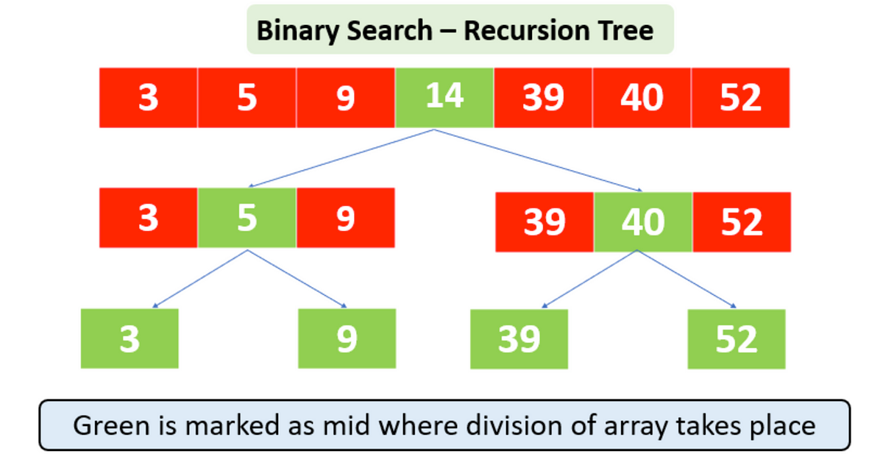
Binary Search
A search algorithm that finds the position of a target value within a sorted array by repeatedly dividing the search interval in half.
How It Works:
Start with the entire array as the search interval.
Calculate the middle index of the current interval.
Compare the middle element with the target value:
If equal, return the middle index.
If the target is less than the middle element, repeat the search on the left half.
If the target is greater, repeat the search on the right half.
Continue until the target is found or the interval is empty.
Time Complexity:
O(log n) where n is the number of elements in the array.
Space Complexity:
O(1) for the iterative version; O(log n) for the recursive version due to function call stack.
Use Cases:
Searching in large sorted arrays or lists.
Efficient data retrieval where data is sorted.

Slide 6
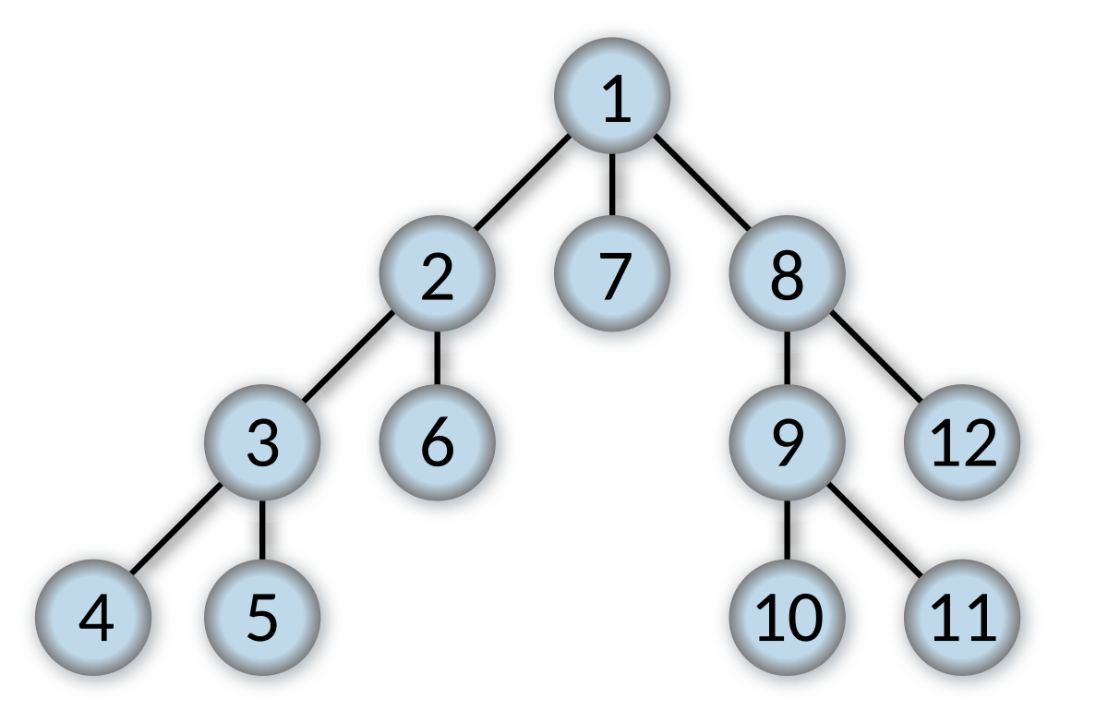
DFS Search
Definition:
DFS is a tree traversal technique that explores as deep as possible along each branch before backtracking.
Applications:
Commonly used in tree/graph traversals, pathfinding, and searching in data structures.
Types of DFS Traversals:
Preorder: Root, Left, Right
Inorder: Left, Root, Right
Postorder: Left, Right, Root
Example Use Case: Searching for a specific value in a tree.

Slide 7
BFS Search
Definition:
DFS is a tree traversal technique that explores as deep as possible along each branch before backtracking.
Applications:
Commonly used in tree/graph traversals, pathfinding, and searching in data structures.
Types of DFS Traversals:
Preorder: Root, Left, Right
Inorder: Left, Root, Right
Postorder: Left, Right, Root
Example Use Case: Searching for a specific value in a tree.

